Slide 1
Kids and Covid
Skills for effective parenting in this stressful time.

Slide 2
Helping kids cope with Covid
Watch for Behavior Changes in your child
Excessive crying or irritation
Returning to behaviors they outgrew
Worrying or sadness
Unhealthy sleeping or eating habits
Irritability and acting out
Peer school performance or avoiding school
Difficulties with attention and concentration
Avoidance of activities they used to enjoy
Unexplained headaches or body pain
Alcohol, tobacco or other drugs

Slide 3
Ways to support your child
Talk with your child about the COVID-19 outbreak.
Answer questions and share facts about COVID-19 in a way that your child can understand.
Reassure your child that they are safe.
Limit your family’s exposure to news coverage of the event, including social media.
Try to keep up with regular routines.
Be a role model.
Connect
Spending time with your child in meaningful activities

Slide 4
Talking with your child about the COVID 19 outbreak
Tips for talking to children
Remain calm.
Reassure children
Make yourself available to listen and to talk.
Avoid language that might blame others .
Pay attention to what children see or hear
Provide information that is truthful and appropriate
Teach children everyday actions to reduce the spread of germs.

Slide 5
Some example of answers for commonly asked questions
COVID-19 is the short name for “coronavirus disease 2019.”
Recently, this virus has made a lot of people sick. Scientists and doctors are trying to learn more so they can help people who get sick.
You can help by practicing healthy habits
COVID-19 can look different in different people.
Most people who have gotten COVID-19 have not gotten very sick. Only a small group of people who get it have had more serious problems.
If you do get sick, it doesn’t mean you have COVID-19

Slide 6
Take care of yourself!!!

Slide 7
Coping with stress
Know what to do if you are sick and are concerned about COVID-19.
Know where and how to get treatment
Take care of your emotional health.
Take breaks from watching, reading, or listening to news stories,
Try to eat healthy, well-balanced meals.
Exercise regularly.
Get plenty of sleep.
Avoid excessive alcohol and drug use.
Make time to unwind.
Connect with others.
Connect with your community- or faith-based organizations

Slide 8
Get immediate help in a crisis
Call 911
Disaster Distress Helplineexternal icon: CALL or TEXT 1-800-985-5990 (press 2 for Spanish).
National Suicide Prevention Lifelineexternal icon: 1-800-273-TALK (8255) for English, 1-888-628-9454 for Spanish, or Lifeline Crisis Chatexternal icon.
National Domestic Violence Hotlineexternal icon: 1-800-799-7233 or text LOVEIS to 22522
National Child Abuse Hotlineexternal icon: 1-800-4AChild (1-800-422-4453) or text 1-800-422-4453
National Sexual Assault Hotlineexternal icon: 1-800-656-HOPE (4673) or Online Chatexternal icon
The Eldercare Locatorexternal icon: 1-800-677-1116 TTY Instructionsexternal icon
Veteran’s Crisis Lineexternal icon: 1-800-273-TALK (8255) or Crisis Chatexternal icon or text: 8388255
Find a health care provider or treatment for substance use disorder and mental health
SAMHSA’s National Helplineexternal icon: 1-800-662-HELP (4357) and TTY 1-800-487-4889
Treatment Services Locator Websiteexternal icon
Interactive Map of Selected Federally Qualified Health Centersexternal icon

Slide 9
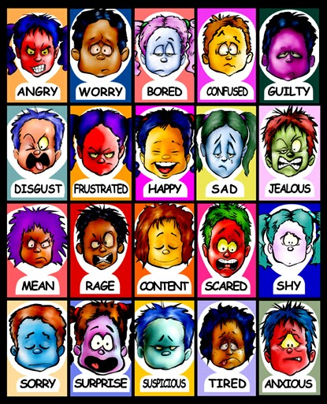
After it is over
Emotional parts of recovery
It can be stressful to be separated from others
Emotional reactions may include:
Mixed emotions, including relief.
Fear and worry about health
Stress from the experience of having COVID-19
Sadness, anger, or frustration because friends or loved ones have fears
Guilt
Worry about getting re-infected or sick
Children may also feel upset or have other strong emotions if they, or someone they know, has COVID-19,

Slide 10
Jeremys Journey of Hope and Healing
https://www.nctsn.org/resources/ready-remember-jeremys-journey-of-hope-and-healing-video

Slide 11
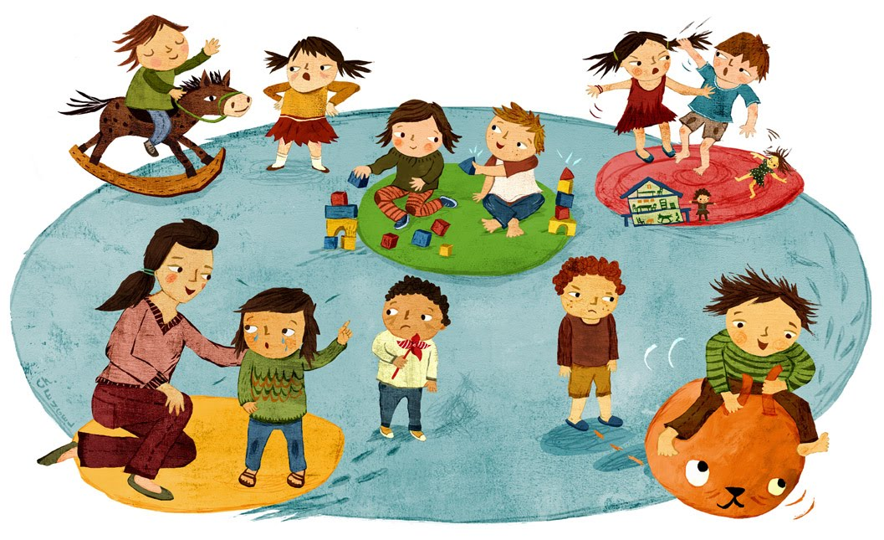
Things to do with your kids
https://docs.google.com/document/d/1SvIdgTx9djKO6SjyvPDsoGlkgE3iExmi3qh2KRRku_w/mobilebasic?fbclid=IwAR3RqF0-ZacfMUnf8cNouk5juHKxu7_inh9J81elIshLrcSse-kQ4y8mi1c
https://www.travelandleisure.com/attractions/museums-galleries/museums-with-virtual-tours?utm_source=facebook.com&utm_medium=social&utm_campaign=social-share-article&utm_content=20200313&fbclid=IwAR17kxdkf028l4OijnKf0wnG69P2Ftt1jzZUdATri5xuxH6JUtPXPvv4C7E
https://docs.google.com/document/d/1LHDofFHd4T-bOtLpDvnjldA37zf33y_Fz0awpr7S__s/mobilebasic?fbclid=IwAR2NtYlShiu4OnESqXV9KNPMpzU8G4S-1LEQWNbHkpVsINy0DGbUcgqRsZ8&usp=gmail

Slide 12
References and resources
https://www.cdc.gov/coronavirus/2019-ncov/daily-life-coping/for-parents.html
https://www.cdc.gov/coronavirus/2019-ncov/daily-life-coping/managing-stress-anxiety.html
https://www.cdc.gov/coronavirus/2019-ncov/daily-life-coping/children.html
https://www.cdc.gov/coronavirus/2019-ncov/daily-life-coping/children/learning.html
https://www.cdc.gov/coronavirus/2019-ncov/community/schools-childcare/decision-tool.html
https://www.cdc.gov/coronavirus/2019-ncov/daily-life-coping/parental-resource-kit/index.html

Slide 13
https://www.cdc.gov/coronavirus/2019-ncov/daily-life-coping/talking-with-children.html
https://www.aacap.org/App_Themes/AACAP/Docs/latest_news/2020/Helping-Kids-Cope-While-Sheltering-in-Place.pdf
https://28638781-c0c7-460f-81ae-fa6eba3486b9.filesusr.com/ugd/517d15_915f31f39df449a2837c11862a7ab39c.pdf
https://www.aacap.org/AACAP/Families_and_Youth/Facts_for_Families/FFF-Guide/Children-And-Grief-008.aspx
https://www.nctsn.org/resources/ready-remember-jeremys-journey-hope-and-healing
https://www.inquirer.com/health/expert-opinions/homeschooling-teen-adhd-coronavirus-20200402.html

Slide 14
https://docs.google.com/document/d/1SvIdgTx9djKO6SjyvPDsoGlkgE3iExmi3qh2KRRku_w/mobilebasic?fbclid=IwAR3RqF0-ZacfMUnf8cNouk5juHKxu7_inh9J81elIshLrcSse-kQ4y8mi1c
https://www.travelandleisure.com/attractions/museums-galleries/museums-with-virtual-tours?utm_source=facebook.com&utm_medium=social&utm_campaign=social-share-article&utm_content=20200313&fbclid=IwAR17kxdkf028l4OijnKf0wnG69P2Ftt1jzZUdATri5xuxH6JUtPXPvv4C7E
https://docs.google.com/document/d/1LHDofFHd4T-bOtLpDvnjldA37zf33y_Fz0awpr7S__s/mobilebasic?fbclid=IwAR2NtYlShiu4OnESqXV9KNPMpzU8G4S-1LEQWNbHkpVsINy0DGbUcgqRsZ8&usp=gmail
https://wideopenschool.org/
https://wideopenschool.org/student-activities/emotional-well-being/grades-3-5/#all/

Slide 15
https://iacapap.org/remember-surviving-the-pandemic-with-your-children/
https://www.npr.org/2020/03/27/816575527/comic-how-to-turn-your-home-into-a-school-without-losing-your-sanity
https://childmind.org/article/when-siblings-wont-stop-fighting/
https://thefamilydinnerproject.org/blog/pandemic-2020-our-stuck-at-home-guide-to-food-fun-and-conversation/
https://www.mayoclinic.org/diseases-conditions/coronavirus/in-depth/help-kids-cope-with-loneliness-covid19/art-20490135
https://blog.chocchildrens.org/7-ways-to-help-kids-cope-with-coronavirus-covid-19-anxiety/
https://www.apa.org/pubs/magination/covid-19-help-kids-cope

